Slide 1
My Favorite Apps
R

Russ Webb
For these slides ⇨ https://db.tt/s0d4tDg1
Notes:
To view this presentation, first, turn up your volume and second, launch the self-running slide show.

Slide 2
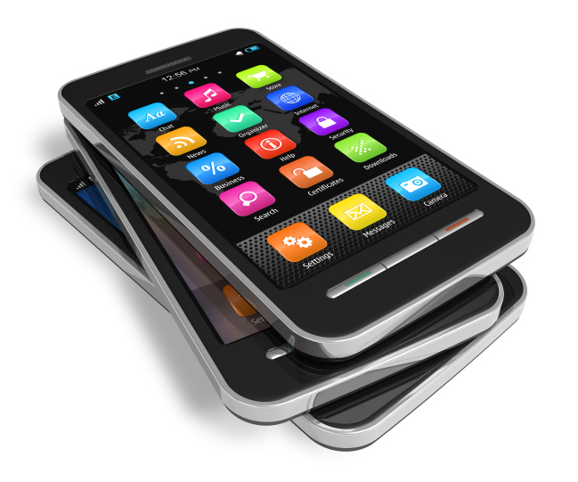
Get out your cell phone
587-409-2973
Text the message to ⇨ 587-409-2973
Please text the following message ⇨ @mhc9322
There are no fees or charges or long distance for sending this text.
Thanks.
@mhc9322

Slide 3
Ever wished your phone would silence for class automatically and come back on automatically when class is over? Or for a meeting? Or an event?

Slide 4
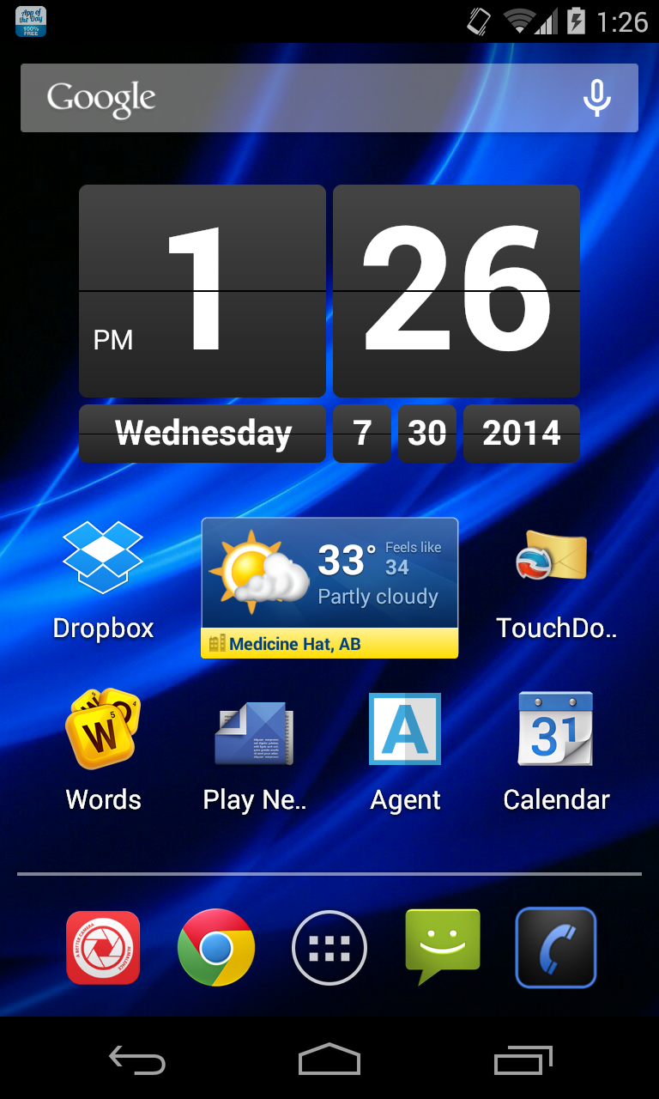
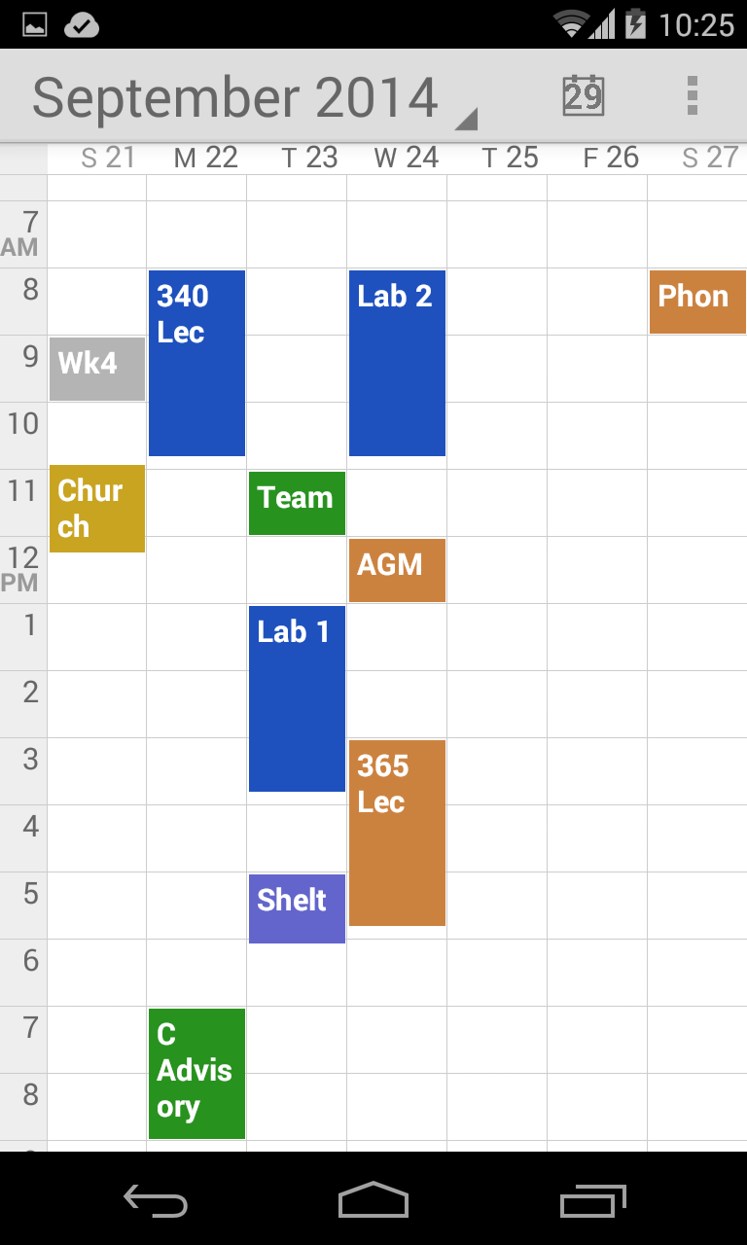
Google Calendar
& Agent
Google Calendar
Great app for scheduling all appointments, classes, meetings, birthdays and more
Gives you reminders before the events & meetings
Can schedule a meeting with a student anywhere

Slide 5
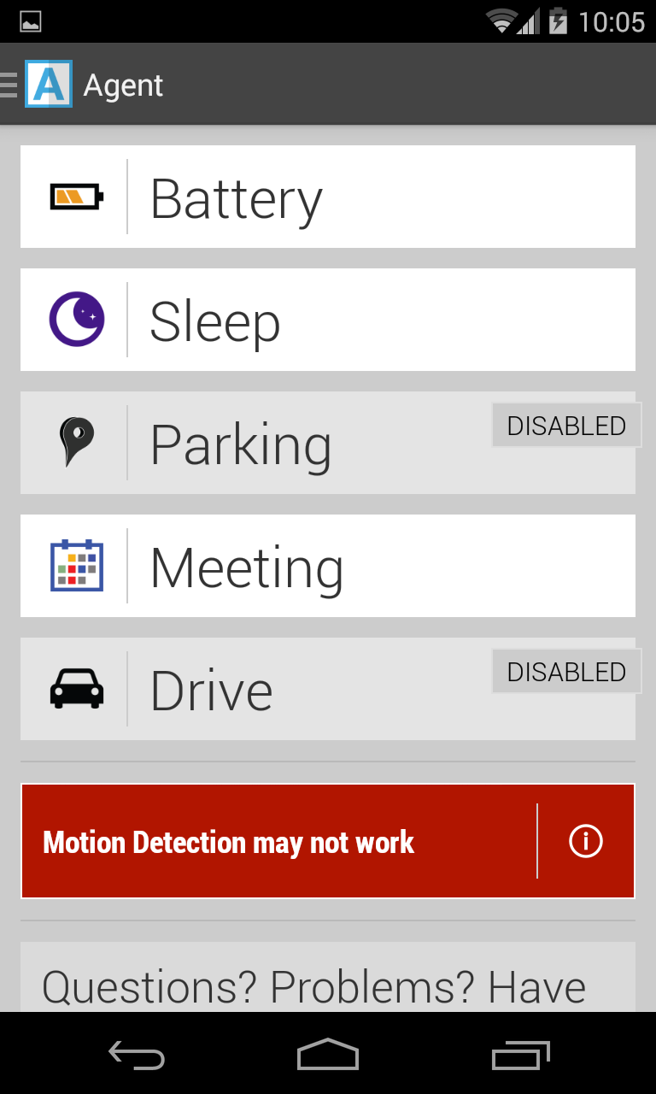
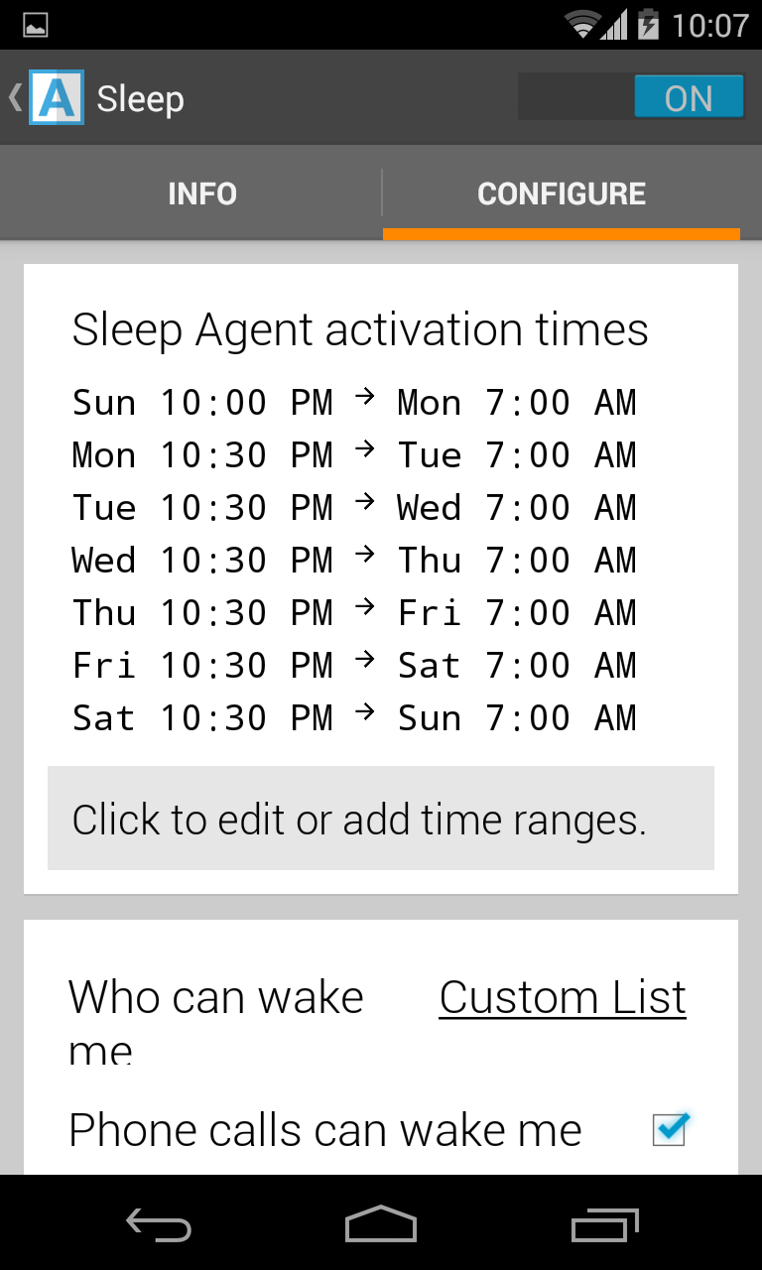
Agent
Really 5 Apps in one
Will only focus on two functions
SLEEP – set up when you want to silence your phone automatically and wake it up automatically

Slide 6
Agent
MEETING – set up when you want to silence your phone automatically and turn it back on automatically
Links into Google Calendar so knows when to silence phone for any meeting or class and when to un-silence it too.

Slide 7
Why use
Agent
Silences my phone automatically for classes and meetings
Turns back on automatically
Exceptions can be made – (ie: my wife can text or call me anytime, but no one else)
Free – fits my budget

Slide 8
Google Calendar
& Agent
Google Calendar Agent
www.google.com/calendar tryagent.com

Slide 10
Ever wished you could have a group discussion through text message rather than always using email? Do you despise when you have to answer the same question repeatedly by email?

Slide 11
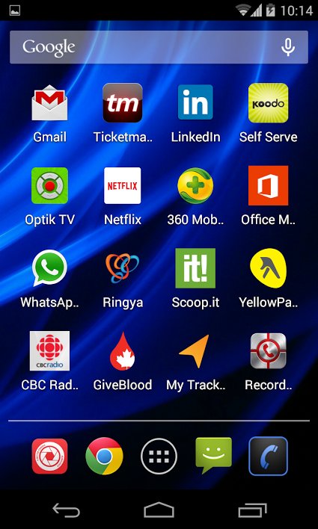
WhatsApp
A group texting App
Communicating with an entire group immediately as a group discussion
Cross platform
Everyone sees every text
Free for the student
Free for the teacher
After 1 year – 99 cent fee
www.whatsapp.com

Slide 12
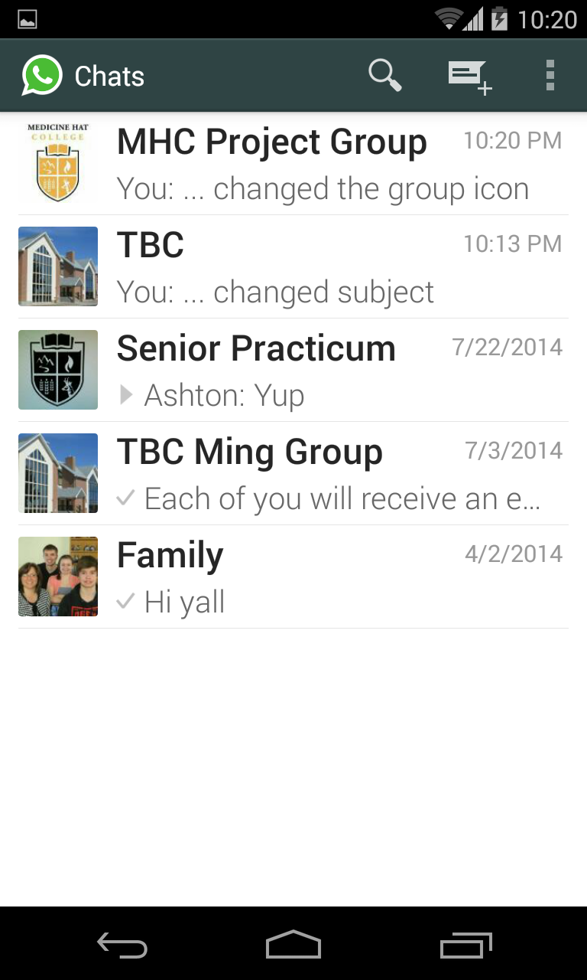
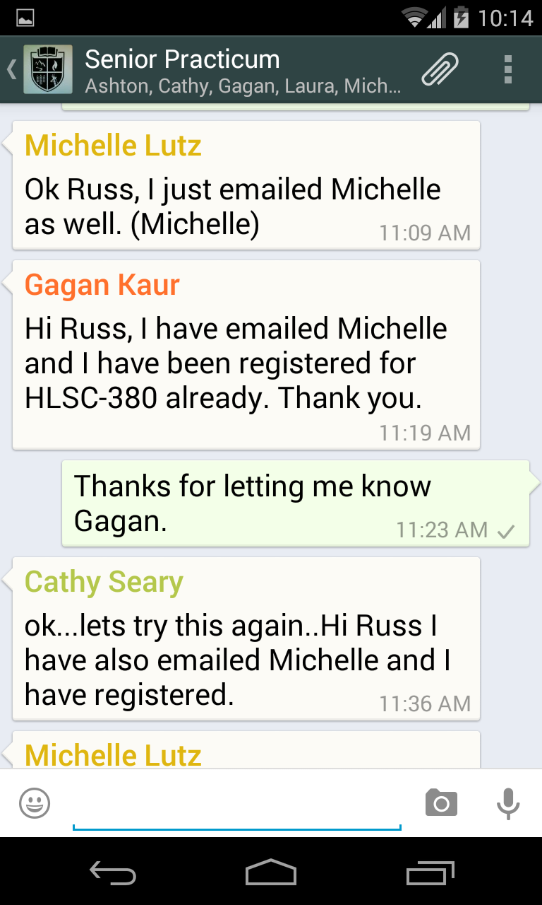

Slide 13
Why use
WhatsApp
Functions the same as BB Discussion Board except you know students will actually see it.
More interactive with your students
I use it:
With smaller groups of students (Practicum Students, Online Students, Smaller Labs, DL courses, committees)
To deal with student questions – each student benefits from other students’ questions
Because I benefit as I give one answer and all students see the one answer
With project groups & leadership groups as well

Slide 14
WhatsApp
www.whatsapp.com
Available on iTune Store & Play Store

Slide 15
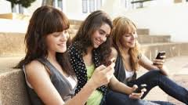
Ever wished you could have told a class of students to bring an auxiliary text to next class, but forgot? Ever emailed the class to bring something to class and only half of the class read the email?

Slide 16
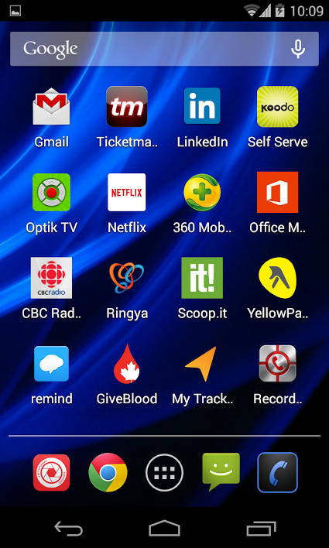
A class texting app
Communicating one-way to entire class immediately or having a reminder text sent at a future point
Your cell number is not given to students
Used by 1 in 5 teachers in the United States
Free for the students
Free for the teacher
www.remind.com

Slide 17
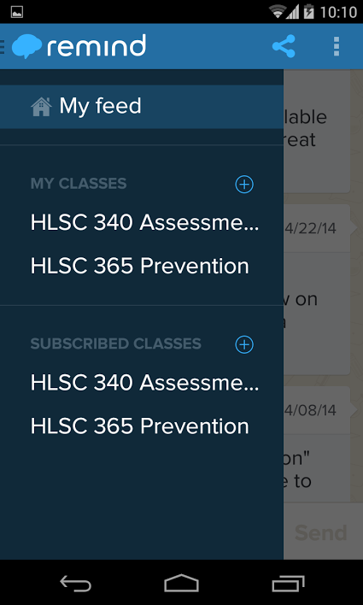
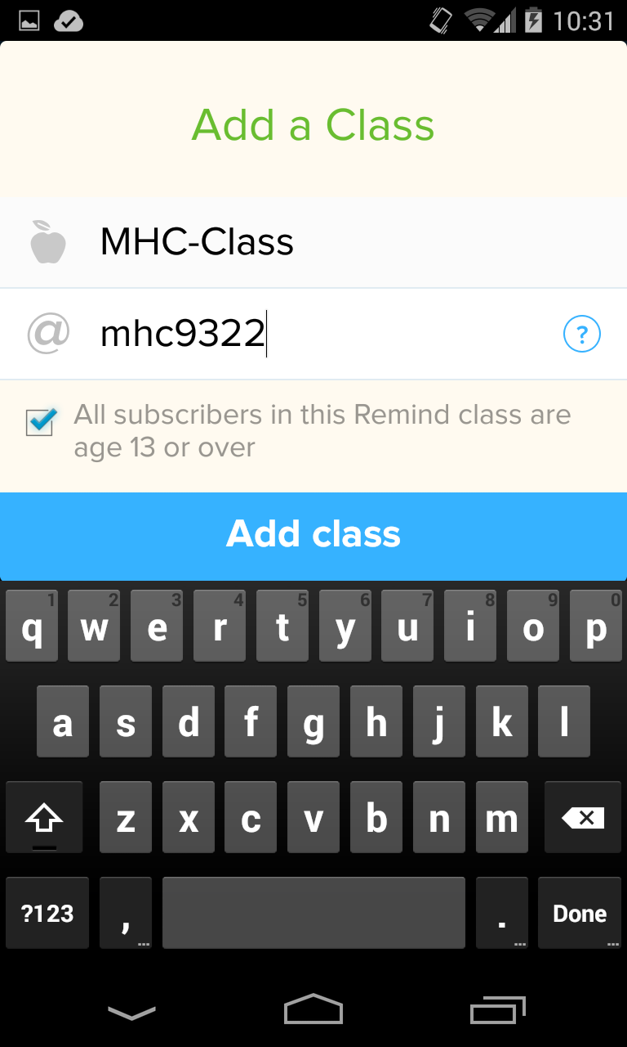
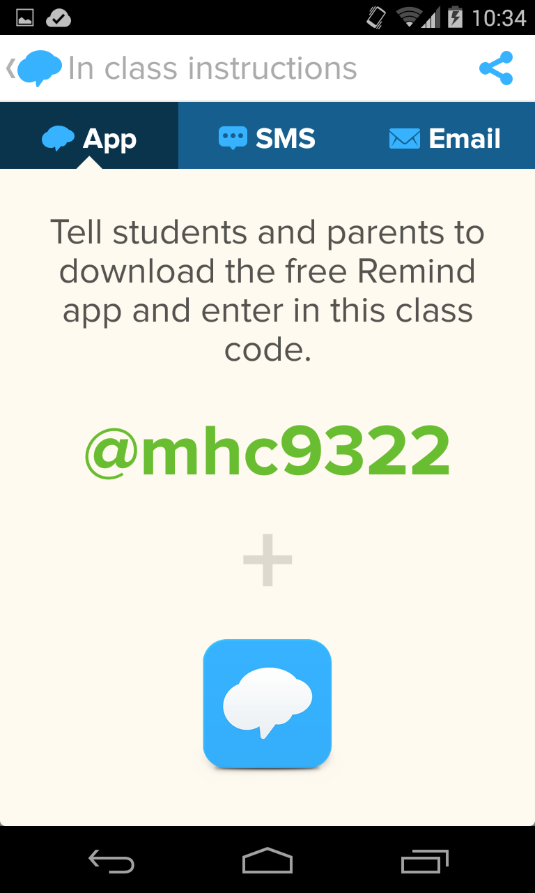
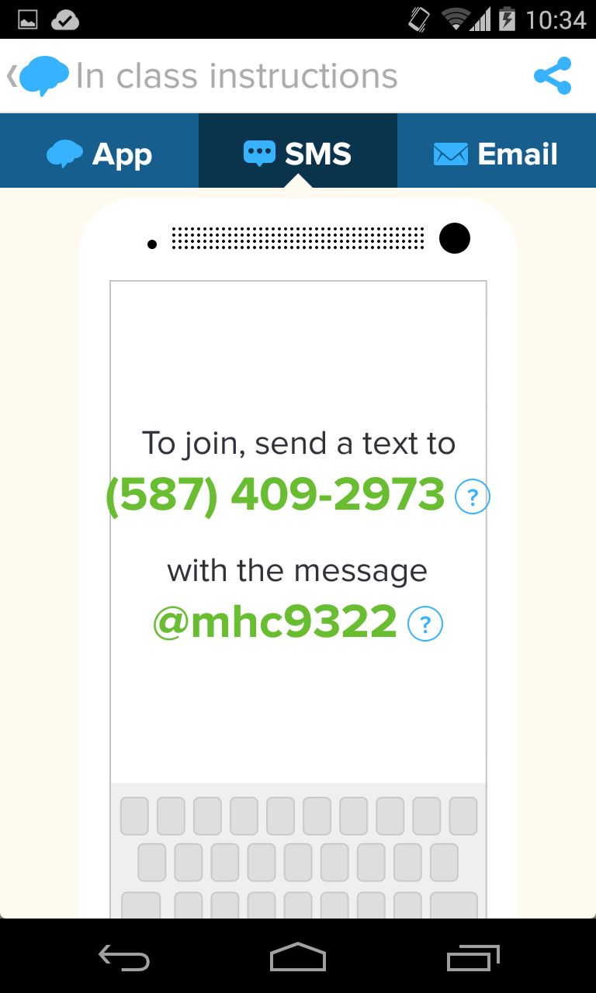

Slide 18
Why use
Students don’t always look at their emails in a timely way, but they do always look at their phones
Students appreciate the reminders
I use it to:
Remind students to bring a certain text for a lab or class
Tell students if location of class or lab has changed
Tell students when test grades are on BB
Tell students when I have put something new up onto BB (ie: lecture notes or a new resource)
Tell students important info between classes

Slide 19
Earlier you joined my “class”
587-409-2973
You signed up earlier.
Now I will send out a reminder to you all.
Note that you (and students) can not text back the Instructor.
@mhc9322

Slide 20
My Favorite Apps
Google Calendar
Agent
WhatsApp
Remind
R

Russ Webb
For these slides ⇨ https://db.tt/s0d4tDg1
Notes:
To view this presentation, first, turn up your volume and second, launch the self-running slide show.

